Slide 1

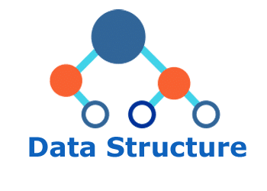
Data structure
(in c)
Lecture 4

Slide 2

Today’s Agenda
Moving Ahead with STACK
What is a Pseudocode?
Pseudocode for Push and Pop.
Implementing STACK.
Implementing Push.
Implementing Pop.

Slide 3
What is a Pseudocode?
The term pseudocode in programming is describing each step to be taken for performing a particular operation.
The pseudocode never considers any language nor it mentions exact syntax of a particular language.
The pseudocode only describes the steps in PLAIN ENGLISH and the programmer/coder has to implement it in any language choice.

Slide 4
Pseudocode For Push
Check for the overflow.
If the stack is overflow then print “Stack overflow” and return.
Increment tos by 1.
Insert the element in the stack at the position pointed by tos.
Finish and return.

Slide 5
Pseudocode for Pop
Check for the Underflow.
If the stack is underflow then print “Stack Underflow” and return.
Remove the element in the stack at the position pointed by tos.
Decrement tos by 1.
Return the deleted element.

Slide 6
Implementing Push & Pop
Before Implementing Push & Pop we have to remember three key points –
We have to declare Push & Pop prototype.
We have to pass argument in them as pass by reference.
Then call these functions from main.

Slide 7
Implementing Stack
include<conio.h>
include< stdio.h>
struct Stack
{
int arr[5];
int tos;
}
void push(struct Stack *, int);
int pop(struct Stack *);
void main()
{
struct Stack s;
int x, i;
s.tos=-1;
clrscr();
for(i=0;i<6;i++)
{
printf(“Enter element:”);
scanf(“%d”,&x);
push(&s,x);
}
for(i=0;i<6;i++)
{
x=pop(&s);
printf(“\nPopped Element:%d”,x);
}
getch();
}

Slide 8
Defining Push
void push(struct Stack *p, int x)
{
if(p->tos==4)
{
printf(“Stack Overflow”);
return;
}
p->tos++;
p->arr[p-tos]=x;
}

Slide 9
Defining Pop
int pop(struct Stack *p)
{
if(p->tos==-1)
{
printf(“Stack Underflow”);
return -1;
}
return p->arr[p-tos--];
}

Slide 10
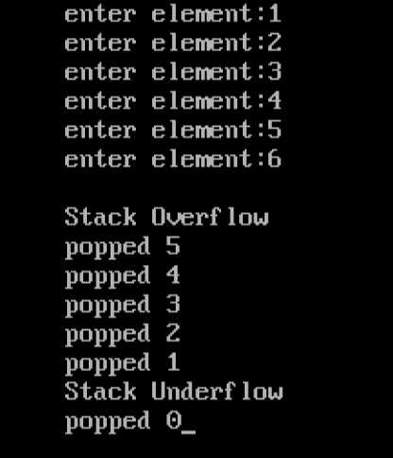
Output
Popping Starts from here
4
3
2
1
0
50
40
30
20
10
4
tos
.
.
.
.
arr
-1
tos

Slide 11
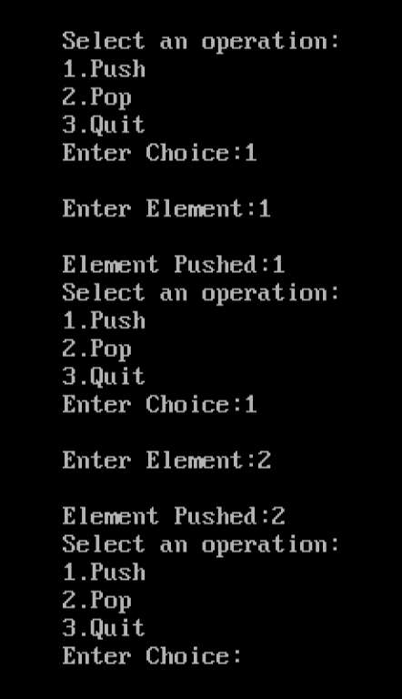
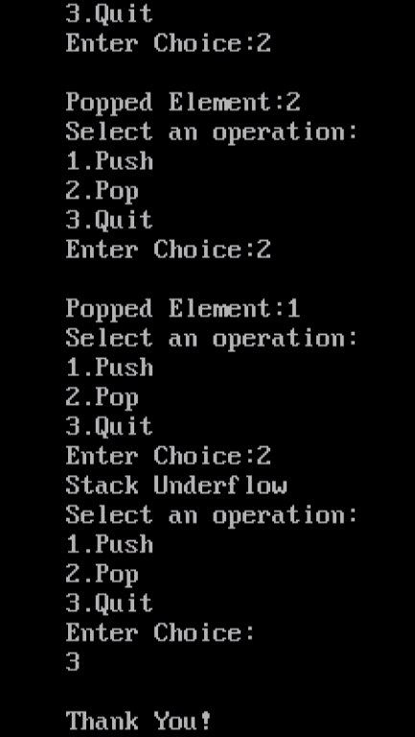
Assignment
Modify the main() function of the previous code so that it becomes choice based i.e. let the user decide whether he wants to push or whether he wants to pop the element from the Stack.
OUTPUT:

Slide 12
Assignment
#include<stdio.h>
#include<conio.h>
struct Stack
{
int arr[5];
int tos;
};
void push(struct Stack *, int);
int pop(struct Stack *);
int main()
{
struct Stack s;
int choice,x,i;
s.tos=-1;
clrscr();
do{
printf("\nSelect anopperation:\n1.PUSH\n2.POP\n3.QUIT\nEnter your choice: ");
scanf("%d",& choice);
switch (choice)
{
case 1:
printf("\nEnter element:");
scanf("%d",&x);
push(&s,x);
break;
case 2:
x=pop(&s);
if(x!=-1)
printf("\nPopped Element:%d",x);
break;

Slide 13
Assignment
case 3:
printf("\nTHANK YOU");
break;
default :
printf("\nWrong choice ! Try again");
}
}while(choice!=3);
return 0;
}
void push(struct Stack *p, int x)
{
if(p->tos==4)
{
printf("\nStack Overflow");
return ;
}
p->tos++;
p->arr[p->tos]=x;
}

Slide 14
Assignment
int pop(struct Stack *p)
{
if(p->tos==-1)
{
printf("\nStack Underflow");
return -1;
}
return p->arr[p->tos--];
}

